Slide 1

How certain aspects of Olympics have changed over the years and affected medal counts
July 7th, 2021
Wildcats

Slide 2
Introduction
With Tokyo Olympics coming up in a few month, we wanted to look for observable trends and visualize them from what we have learned so far in the course.
Facts:
The first Summer Olympic Games was in 1896; first Winter Games was in 1924.

Slide 3
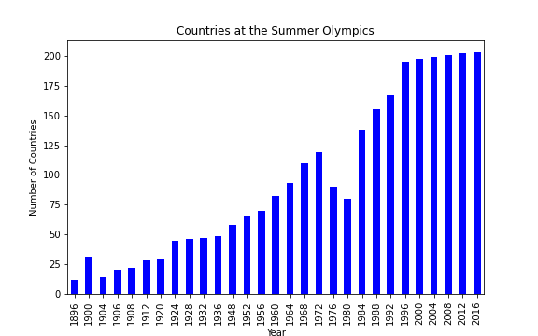

Countries participation over the years
The first Olympic game in 1896 had only (10+) countries to participate while (200+) countries participated in the Olympic game. Significant decrease in the number of countries was seen in 1980 due to many countries boycotting the event.

Slide 4
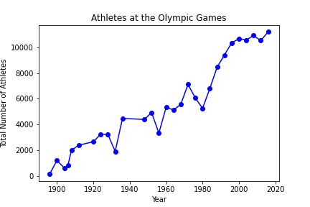
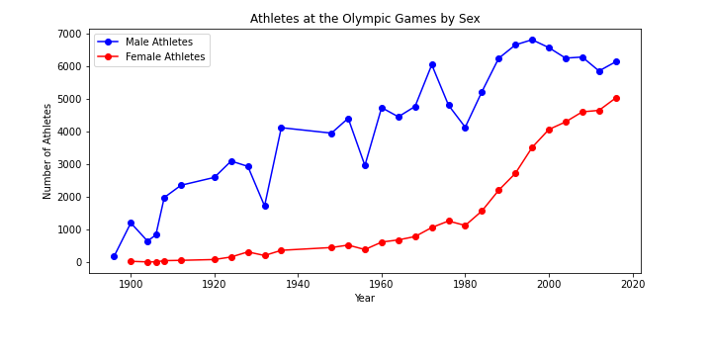


Number of athletes participation over the year
Participation of athletes have naturally increased over the years contributed by significant growth in number of female athletes.

Slide 5
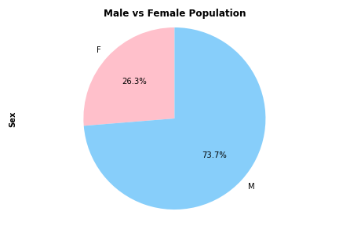
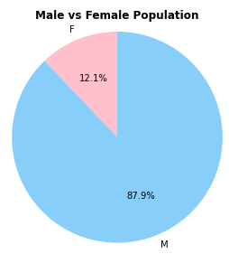
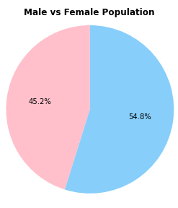



Male vs Female participation change over the years
Number of female athletes have significantly increased over the years from what it was 12.1% of the total population in 1952 which grew to similar number to male at 45.2% in 2016 which indicates gender equality is gradually being achieved in Olympic games from a participants’ point of view.
1952
2016

Slide 6

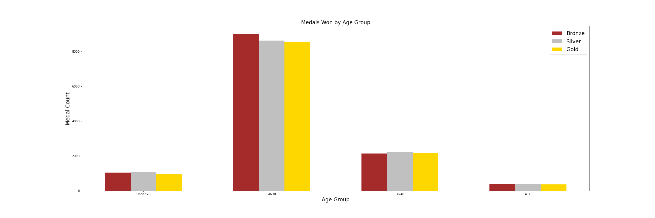
Medals Won by Age Group
The best chance for someone to win any medal would be between the ages of 20-30.

Slide 7
Medals won by countries
Summer/Winter
Top 10 countries?

Slide 8

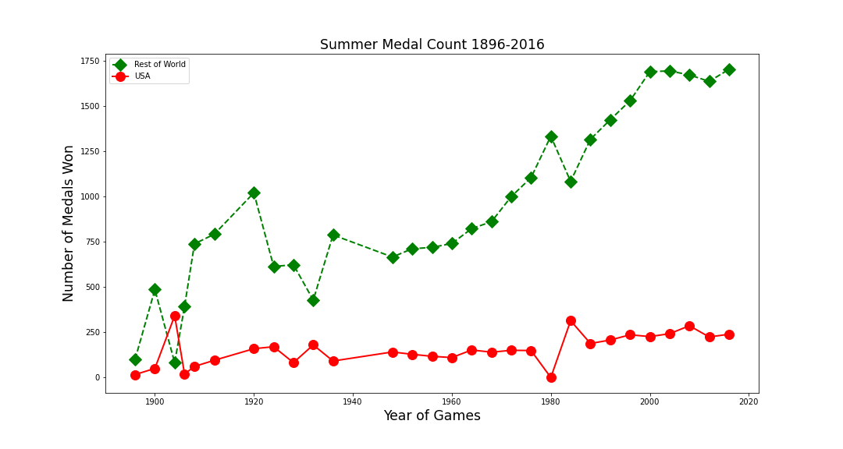
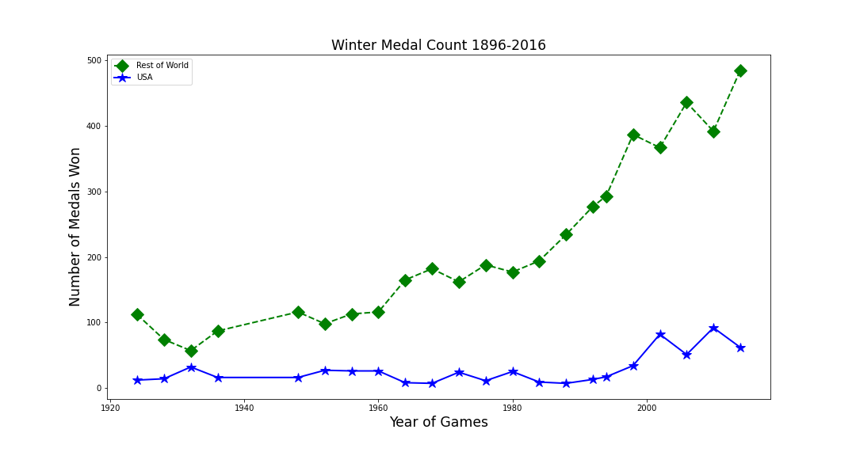

US medals vs the other regions
Early 1900s big jump of US medals vs other regions

Slide 9


Outro
Host nation advantage?

